Slide 1
Windows fundamental's
Team 1
SM MONISHA
N NANDINI
MAHENTESH KUMBAR
ARVETI NAVEEN
T DIVYA SRI
KL SAIKRISHNA

Slide 2
contents
What is Operating system?
Types of Operating System
Kernel
Executive Services

Slide 3
OPERATING SYSTEM

Slide 4
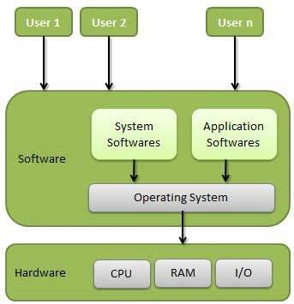
WHAT IS OPERATING SYSTEM?
An operating system, or "OS," is software that communicates with the hardware and allows other programs to run. It is comprised of system software, or the fundamental files your computer needs to bootup and function.

Slide 5

Operating systems
Windows
Linux

Slide 6
Types of operating system
There are Mainly 4 Types of operating systems
Time-sharing operating systems
Distributed operating System
Network operating System
Real Time operating System

Slide 7

Time-sharing operating systems
Time-sharing is a technique which enables many people, located
various terminals,to use a particular computer system at the same time. Time-sharing or multitasking is a logical extension of multiprogramming.

Slide 8
Advantages and dis advantages
Advantages:-
Provides the advantage of quick response.
Avoids duplication of software.
Reduces CPU idle time.
Dis-Advantages:-
Problem of reliability.
Question of security and integrity of user programs and data.
Problem of data communication.

Slide 9
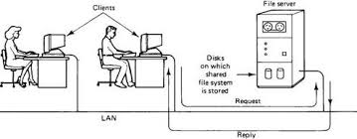
Distributed operating System
Distributed systems use multiple central processors to serve multiple real-time applications and multiple users.
The processors communicate with one another through various communication lines (such as high-speed buses or telephone lines). These are referred as loosely coupled systems or distributed systems.

Slide 10
Advantages of Distributed Operating System
Speedup the exchange of data with one another via electronic mail.
If one site fails in a distributed system, the remaining sites can potentially continue operating.
Better service to the customers.
Reduction of the load on the host computer.
Reduction of delays in data processing.

Slide 11
NETWORK OPERATING SYSTEM
A specialized operating system for a network device such as a router, switch or firewall.
An operating system oriented to computer networking, to allow shared file and printer access among multiple computers in a network, to enable the sharing of data, users, groups, security, applications, and other networking functions, typically over a local area network (LAN), or private network . This sense is now largely historical, as common operating systems generally now have such features included.

Slide 12
There are two types of network operating system.
Peer to peer network
Client and server network
Peer to peer network:-
This is a type of network in which all computers are connected to each other.
It is inexpensive to setup.
Files are placed on any computer and can be accessed by any other computer in the network.
This type of network is best for small or medium size organization.

Slide 13
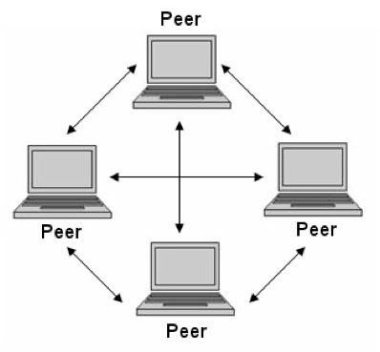
Advantages of peer to peer network:-
It is easy to configure
It is not expensive to setup
Disadvantages of peer to peer network:-
No control over all the computers i.e. decentralized
Security problem
Client and server network
Client and server network:-

Slide 14
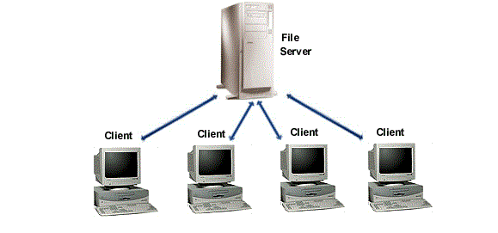
client and server network
This is type of network in which there is a server that is attached to client computer. So one computer is behaving as a center server controlling and managing other computers.

Slide 15
Advantages of client and server network:-
Security is well managed in these systems
New resources can be easily added and removed to these networks
New technology can be put in without any problem
Server can be accessed remotely also
Disadvantages of client and server network:-
It is expensive to setup
Maintenance of these systems require more staff
All computers are dependent on server. If server crashes then all computers effected

Slide 16
REAL time operating system
A real-time operating system is a multitasking operating system designed for real-time applications. Such applications include embedded systems, industrial robots, scientific research equipment and others.
Advantages of real-time operating system :
Maximum Consumption of the system
Task Shifting
Focus on Application

Slide 17
Disadvantages of Real Time Operating System:
Limited Tasks
Use heavy system resources
Low multi-tasking
Complex Algorithms
Thread Priority

Slide 18
Kernel
Kernel is the core or Heart of Operating System.
The kernel is a computer program that is the core of a computer’s operating system with complete control over everything in the system.
It is One of the first program loaded on start up

Slide 19
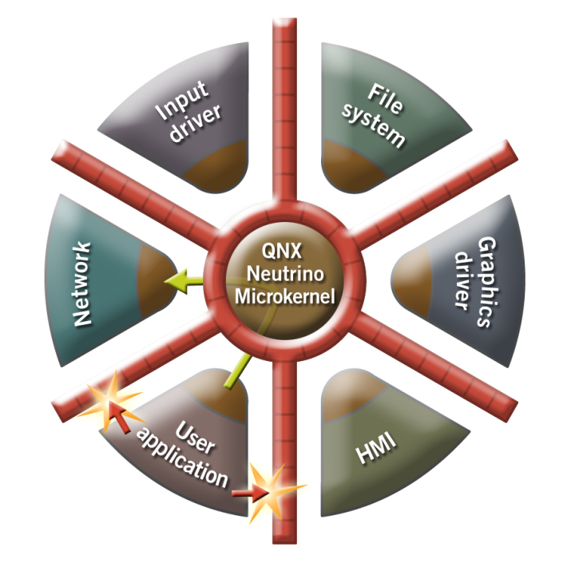
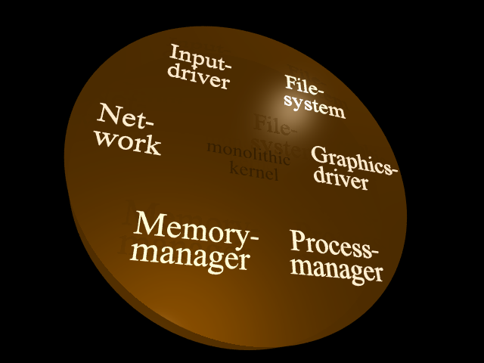
Types of Kernel
Monolithic kernel
Micro Kernel

Slide 20
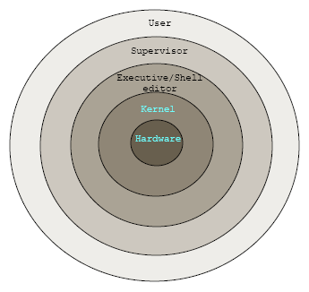
Hybrid Kernel

Slide 21
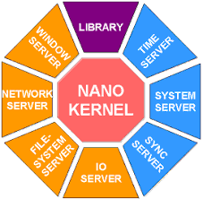
Nano Kernel
Nano was developed by ADEOS.
Widely using in Mobiles.

Slide 22
Kernel architecture

Slide 23
Logon Process winlogon.exe
Win32 Application
L S A
Win32 SubSystem
Win32.sys
S A M
User Mode
I/O Manager
O
EXECUTIVE SERVICES
Kernel Mode
Power manager
Process & Thread Manager
Security Reference manager
Local Procedural Manager
Objct Manager
Memory Manager
Configuration Manager Registry
P &P manager
Kernel Transaction Manager
Cache Manager
Kernel
Window manager
File System
GDI
Network drivers
Device drivers
Hardware Abstraction Layer
Graphics drivers
HARDWARE

Slide 24
Executive Services

Slide 25
Executive services
I/O Manager
Object Manager
Process and Thread Manager
Memory Manager
Security And Reference Manager
Configuration Manager Registry

Slide 26
Executive services
I/O MANAGER
The Windows kernel-mode I/O manager manages the communication between applications and the interfaces provided by device drivers.
They are passed from operating system to specific drivers and from one driver to another.
The communication between the operating system and device drivers is primarily done through I/O request packets (IRPs).

Slide 27
Executive services
I/O MANAGER COMPONENTS:
The I/O manager has two subcomponents:
1.Plug and Play manager
2.Power manager.

Slide 28
Executive services
OBJECT MANAGER:
The Windows kernel-mode object manager component manages objects.
Ex: Files,devices,registry keys, and so on.
An object is a collection of data that the operating system manages.
Windows has more than 25 types of objects.
keeps track of the objects allocated to process.

Slide 29
Executive services
PROCESS AND THREAD MANAGER:
A process is a software program that is currently running in Windows.
A thread is an object that identifies which part of the program is running.
The Windows kernel-mode process and thread manager handles the execution of all threads in a process.

Slide 30
Executive services
Memory Manager :
The Windows kernel-mode memory manager component manages physical memory for the operating system. This memory is primarily in the form of random access memory (RAM).
The memory manager manages memory by performing the following major tasks:
Managing the allocation and deallocation of memory virtually and dynamically.
Supporting the concepts of memory-mapped files, shared memory, and copy-on-write.

Slide 31
Executive services
SECURITY AND REFERENCE MANAGER :
An increasingly important aspect of operating systems is security. Before an action can take place, the operating system must be sure that the action is not a violation of system policy.
For example, a device may or may not be accessible to all requests
The Windows kernel-mode security reference monitor provides routines for your driver to work with access control.
Routines that provide a direct interface to the security reference monitor are prefixed with the letters "Se"; for example, SeAccessCheck.
Generally, higher-level drivers, particularly network drivers, call these routines.

Slide 32
Executive services
CONFIGURATION MANAGER REGISTRY :
In the earlier days of Microsoft Windows, applications and the operating system stored configuration values in "INI" (initialization) files.
The Windows Registry was created to store data about hardware and software.
The Windows kernel-mode configuration manager manages the registry.
Routines that provide a direct interface to the configuration manager are prefixed with the letters "Cm"; for example, ”CmRegisterCallback”.

Slide 33


